Slide 1
YOU
DON'T NEED
jQuery
@joshbroton // joshbroton.com

Slide 2

who
am
i?
Sr Dev + Curmudgeon // Lemonly
You Don't Need jQuery
@joshbroton

Slide 3
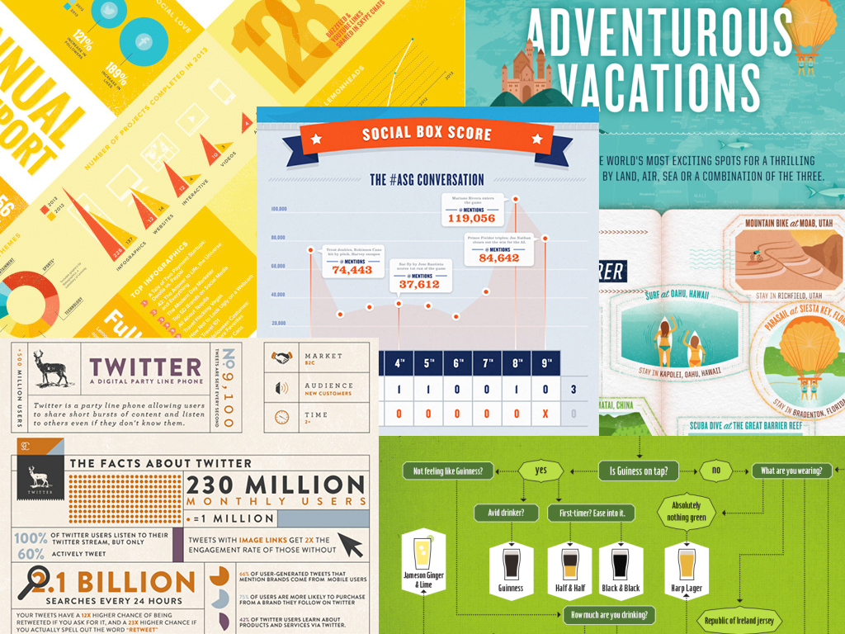
lemonly.com/work
You Don't Need jQuery
@joshbroton

Slide 4
who
am
i?
Sr Dev + Curmudgeon // Lemonly
Founder // standing.io
You Don't Need jQuery
@joshbroton

Slide 5
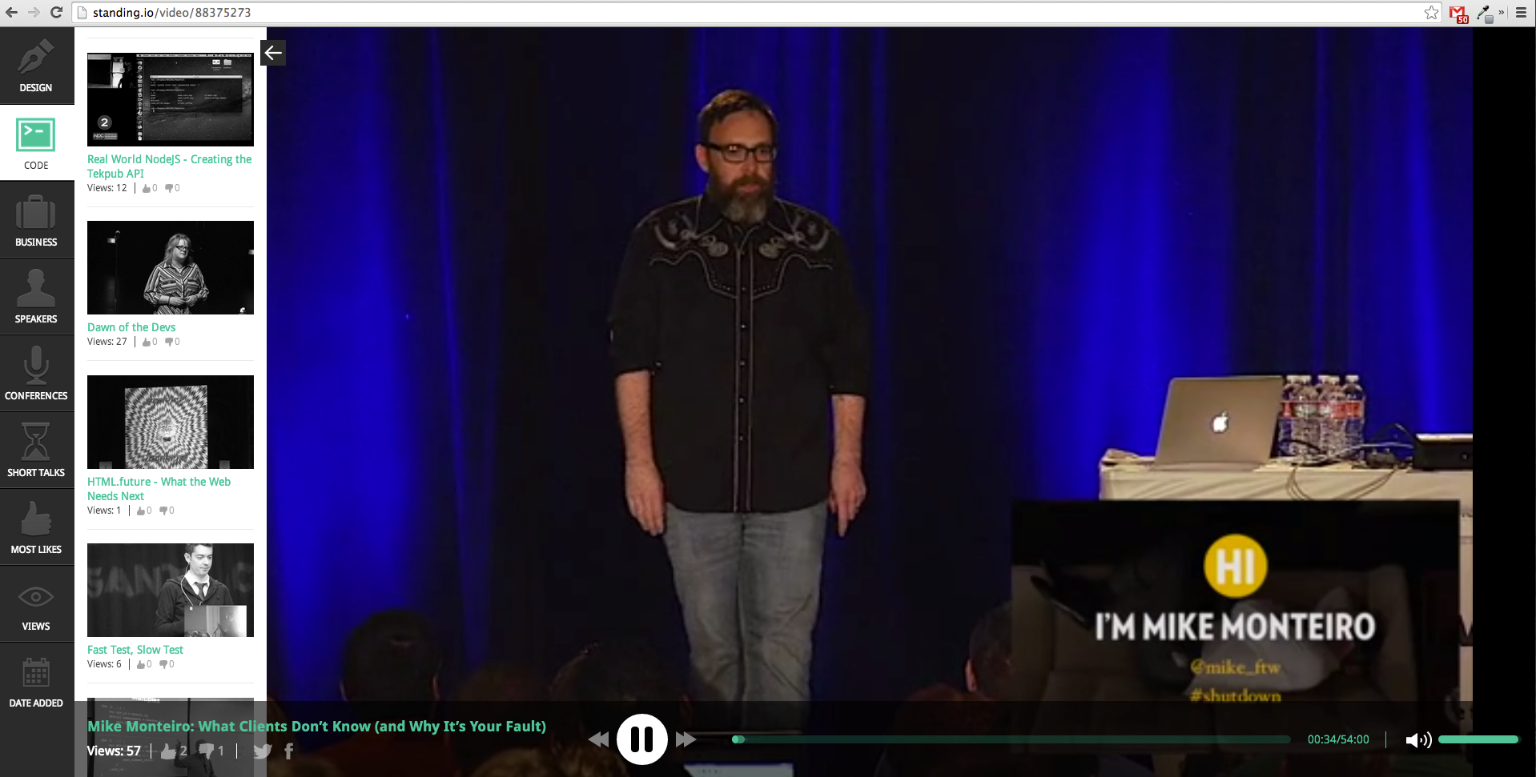
standing.io
(fancy name for a lot of conference videos)
You Don't Need jQuery
@joshbroton

Slide 6
who
am
i?
Sr Dev + Curmudgeon // Lemonly
Founder // standing.io
Frontend Dev // kidblog.org
You Don't Need jQuery
@joshbroton

Slide 7
who
am
i?
Sr Dev + Curmudgeon // Lemonly
Founder // standing.io
Frontend Dev // kidblog.org
Founder // 3themes
You Don't Need jQuery
@joshbroton

Slide 8
3themes?
(More like 1theme, amirite?)
You Don't Need jQuery
@joshbroton

Slide 9
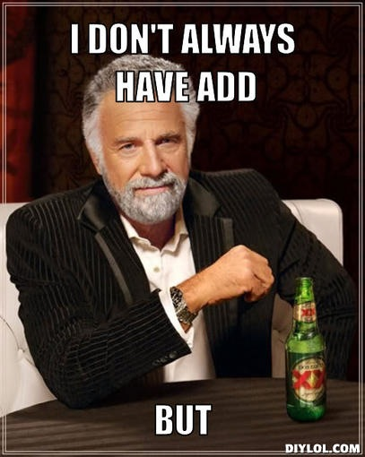
You Don't Need jQuery
@joshbroton

Slide 10

You Don't Need jQuery
@joshbroton

Slide 11
what we're covering
(You still have time to leave...
I hear Nick, Josh, and Carolyn are awesome)
1. You Need jQuery
2. Why you shouldn't use jQuery
3. Replacing jQuery
You Don't Need jQuery
@joshbroton

Slide 12
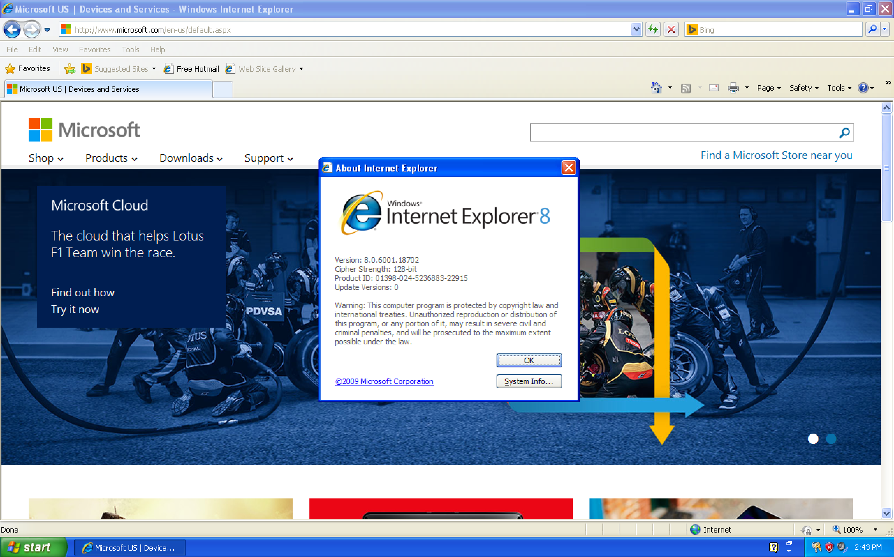
YOU
Need
jquery
You're stuck supporting old browsers. :(
You Don't Need jQuery
@joshbroton

Slide 13

YOU
Need
jquery
You Don't Need jQuery
@joshbroton

Slide 14
YOU Need jquery
You don't control the production environment.
WordPress plugins
CMS users
Unknown dependencies
You Don't Need jQuery
@joshbroton

Slide 15

YOU Need jquery
Customers hate it when you
break all the things.
You Don't Need jQuery
@joshbroton

Slide 16

YOU
Need
jquery
You're vanillaJS averse
You Don't Need jQuery
@joshbroton

Slide 17
what we're covering
1. You Need jQuery
2. Why you shouldn't use jQuery
3. Replacing jQuery
You Don't Need jQuery
@joshbroton

Slide 18
milliseconds matter
"...250 milliseconds can be the difference between a return customer and an abandoned checkout cart."
"...every 100 milliseconds of latency resulted in a 1% loss of sales."
"...lose 20% of their traffic for each additional 100 milliseconds it takes a page to load."
bit.ly/1hZ04et // bit.ly/1jlxMaC
You Don't Need jQuery
@joshbroton

Slide 19
Low-hanging
Fruit
(Download Latency)
"... add roughly 150ms to 1 full second of load time..." - TJ Van Toll
Request Latency: 344ms
Download: 108ms
Average Hit: 452ms
bit.ly/1ncPcg7
You Don't Need jQuery
@joshbroton

Slide 20

Average Hit:
452ms
bit.ly/1ncPcg7
You Don't Need jQuery
@joshbroton

Slide 21
Low-hanging
Fruit
(Parse / Execute)
Parsing and Executing jQuery on mobile:
IE11: 18ms
Safari iOS7: 178ms
Chrome: 15ms
Android 2.2: 1184ms
Safari: 9ms
Android 4.4: 603ms
Average Hit: 535ms
bit.ly/1ncPcg7
You Don't Need jQuery
@joshbroton

Slide 22

Average Hit:
535ms
bit.ly/1ncPcg7
You Don't Need jQuery
@joshbroton

Slide 23
452ms + 535ms =
987ms
bit.ly/1ncPcg7
You Don't Need jQuery
@joshbroton

Slide 24
$('.thing').addClass('active')
You Don't Need jQuery
@joshbroton

Slide 25

but what about a cdn?
"The chance that someone hitting a CDN has [cached your version of] jQuery is 1.7%."
- Alex Sexton
(that's really small)
bit.ly/QnuV92
You Don't Need jQuery
@joshbroton

Slide 26
Other
performance
improvements
Does vanilla JS have speed benefits above jQuery?
Are they worth going after?
bit.ly/1kNgnuk
You Don't Need jQuery
@joshbroton

Slide 27
Other
performance
improvements
What about loops?
JavaScript is ~290x faster
bit.ly/1eNrG5P
You Don't Need jQuery
@joshbroton

Slide 28
Worth the effort?
10ms
+ 10ms
+ 10ms
+ 10ms
+ 10ms
+ 10ms
+ 10ms
+ 10ms
+ 10ms
+ 10ms
+ 10ms
+ 10ms
+ 10ms
+ 10ms
+ 10ms
+ 10ms
+ 10ms
+ 10ms
+ 10ms
+ 10ms
+ 10ms
+ 10ms
+ 10ms
+ 10ms
+ 10ms
+ 10ms
+ 10ms
+ 10ms
+ 10ms
+ 10ms
+ 10ms
+ 10ms
+ 10ms
+ 10ms
+ 10ms
+ 10ms
+ 10ms
+ 10ms
+ 10ms
+ 10ms
+ 10ms
+ 10ms
+ 10ms
+ 10ms
+ 10ms
+ 10ms
+ 10ms
+ 10ms
+ 10ms
+ 10ms
+ 10ms
+ 10ms
+ 10ms
+ 10ms
+ 10ms
+ 10ms
+ 10ms
+ 10ms
+ 10ms
+ 10ms
+ 10ms
+ 10ms
+ 10ms
+ 10ms
+ 10ms
+ 10ms
+ 10ms
+ 10ms
+ 10ms
+ 10ms
= A lot
bit.ly/1kNgnuk
You Don't Need jQuery
@joshbroton

Slide 29

It's. Really. This. Bad.
You Don't Need jQuery
@joshbroton

Slide 30
what we're covering
1. You need jQuery
2. Why you shouldn't use jQuery
3. Replacing jQuery
You Don't Need jQuery
@joshbroton

Slide 31

Replacing
jquery
X
(why we're here today)
You Don't Need jQuery
@joshbroton

Slide 32

You Don't Need jQuery
@joshbroton

Slide 33

You Don't Need jQuery
@joshbroton

Slide 34
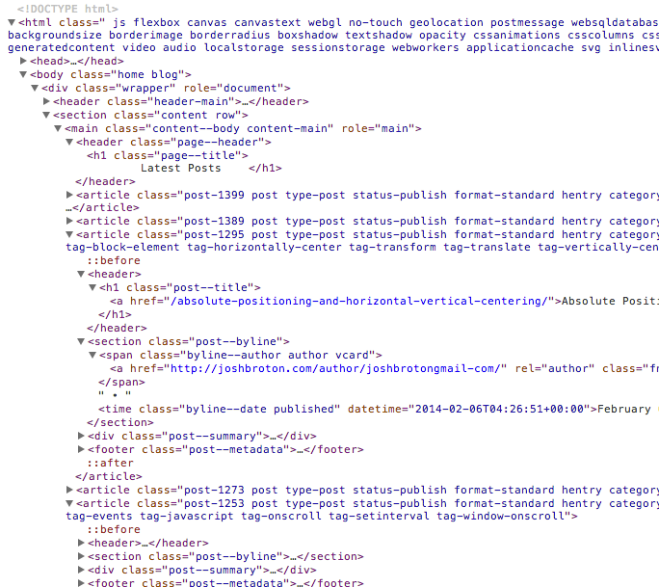
Lesson 1: The dom
"The Document Object Model (DOM) is a cross-platform and language-independent convention for representing and interacting with objects in HTML, XHTML and XML documents.[1] Objects in the DOM tree may be addressed and manipulated by using methods on the objects. The public interface of a DOM is specified in its application programming interface (API)." (wikipedia)
TL;DR: The DOM is the whole set of elements on a page.
JavaScript interacts with the DOM through the native DOM API.
You Don't Need jQuery
@joshbroton

Slide 35
Lesson 1: The dom
jQuery is just another DOM API.
You Don't Need jQuery
@joshbroton

Slide 36
Lesson 1a: DOM NODES
DOM Node
DOM Node
JavaScript is for interacting with these DOM nodes.
DOM Node
Yep... DOM Node
You Don't Need jQuery
@joshbroton

Slide 37
Lesson 2: basic jquery
$('.thing').addClass('new-class');
"Use jQuery..."
"...and do this..."
"...on these nodes..."
"...with this information"
You Don't Need jQuery
@joshbroton

Slide 38
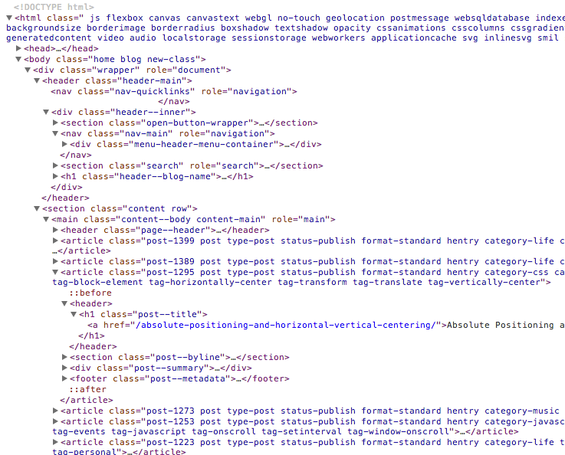
Lesson 3: jquery + DOM nodes
$('.home').addClass('new-class');
You Don't Need jQuery
@joshbroton

Slide 39
Lesson 4:
Vanilla
Javascript
document.querySelectorAll('.thing').className += ' new-class';
"Interact with the DOM..."
"...specifically these nodes..."
"...and do this"
You Don't Need jQuery
@joshbroton

Slide 40
Lesson 5: Javascript + DOM nodes
document.querySelector('.home')
.className += ' new-class';
You Don't Need jQuery
@joshbroton

Slide 41
Lesson 6: javascript selectors
$('body')
document.getElementsByTagName('body')
$('.home')
document.querySelectorAll('selector')
document.querySelectorAll('.home')
$('#home')
document.getElementById('#home')
You Don't Need jQuery
@joshbroton

Slide 42
Lesson 7:
Javascript
Demo
You Don't Need jQuery
@joshbroton

Slide 43
Thank you!
@joshbroton // joshbroton.com

